Slide 1

Dropout on MNIST - Let’s see Source Code

Slide 2
Reference
Source Code
Youtube
Code

Slide 3
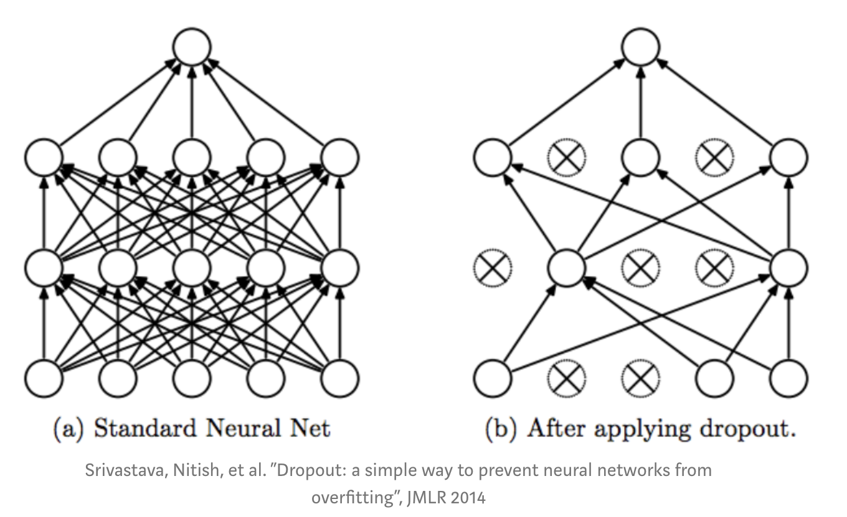
Dropout

Slide 4
Worm Up

Slide 5
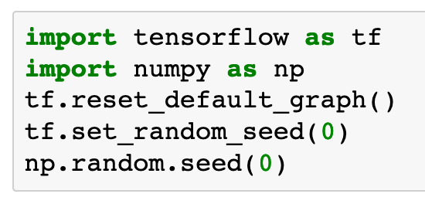

Slide 6
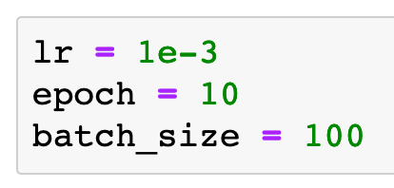

Slide 7
Data

Slide 8
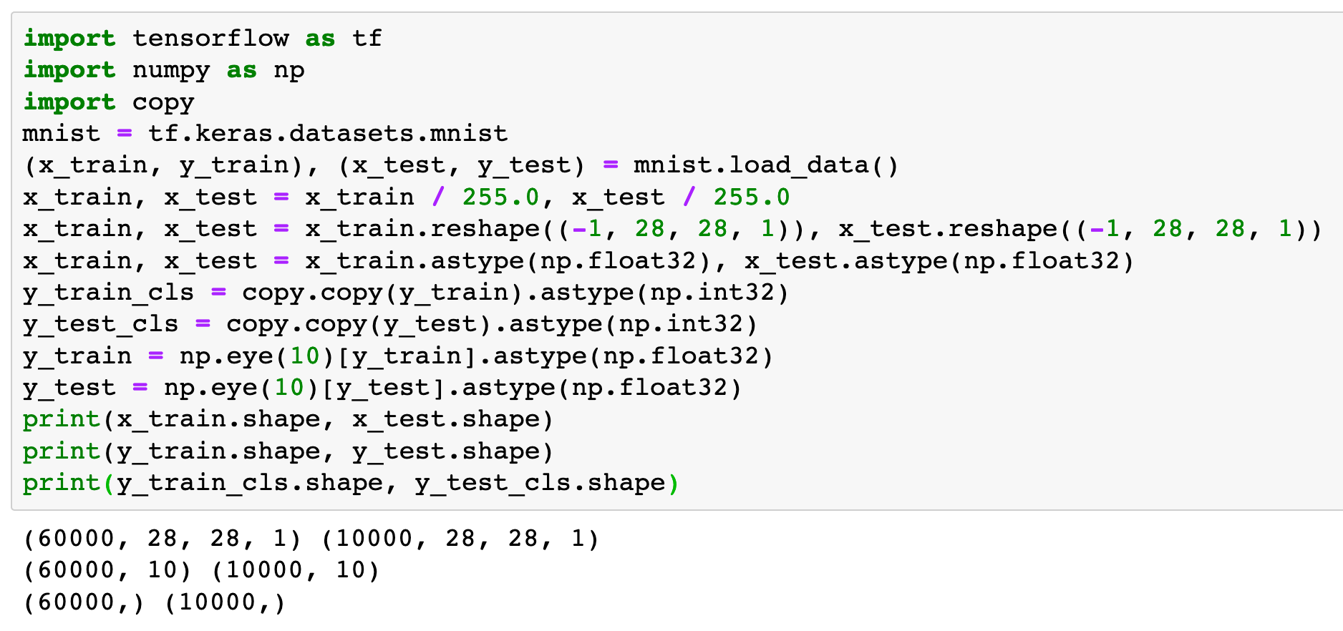

Slide 9
Graph

Slide 10
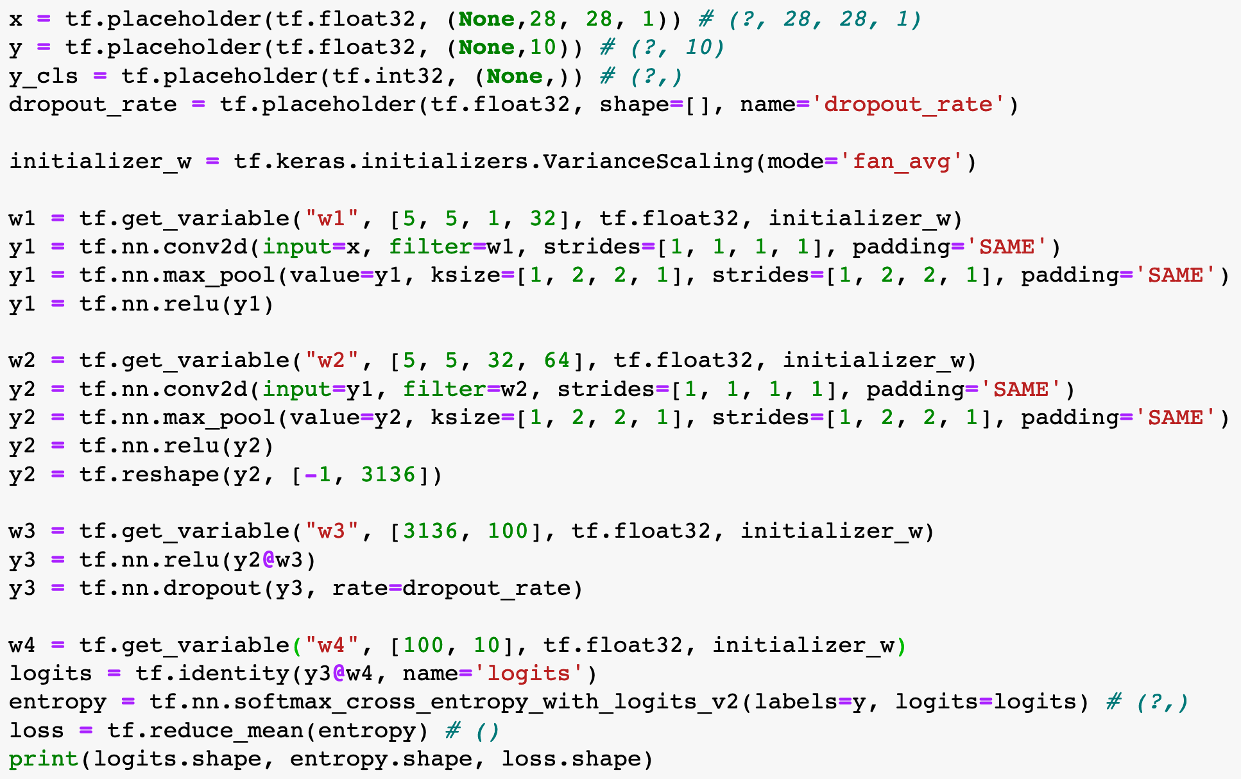

Slide 11
These Lines are added

Slide 12
These Lines are added

Slide 13
Adam

Slide 14
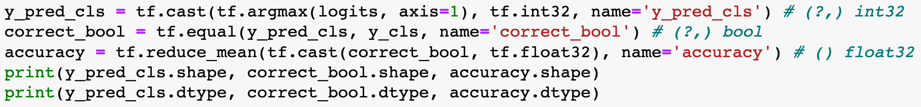

Slide 15
Session

Slide 16
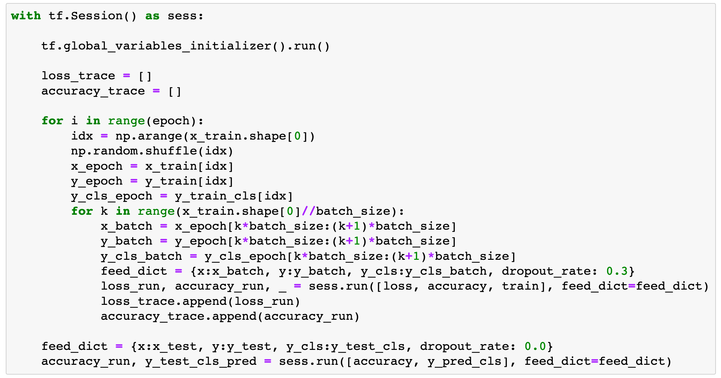

Slide 17
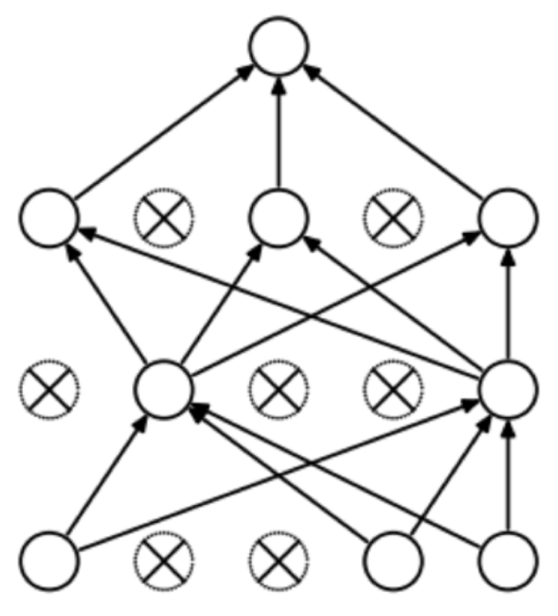
Train Period

Slide 18
During train
we dropout about 30% of nodes

Slide 19
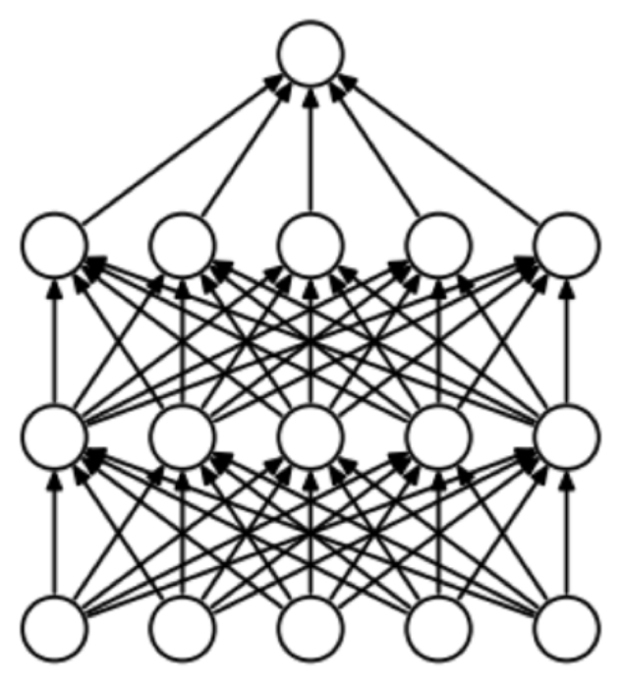
Test Period

Slide 20
During test
we don’t dropout at all
During train
we dropout about 30% of nodes

Slide 21
Report Result

Slide 22
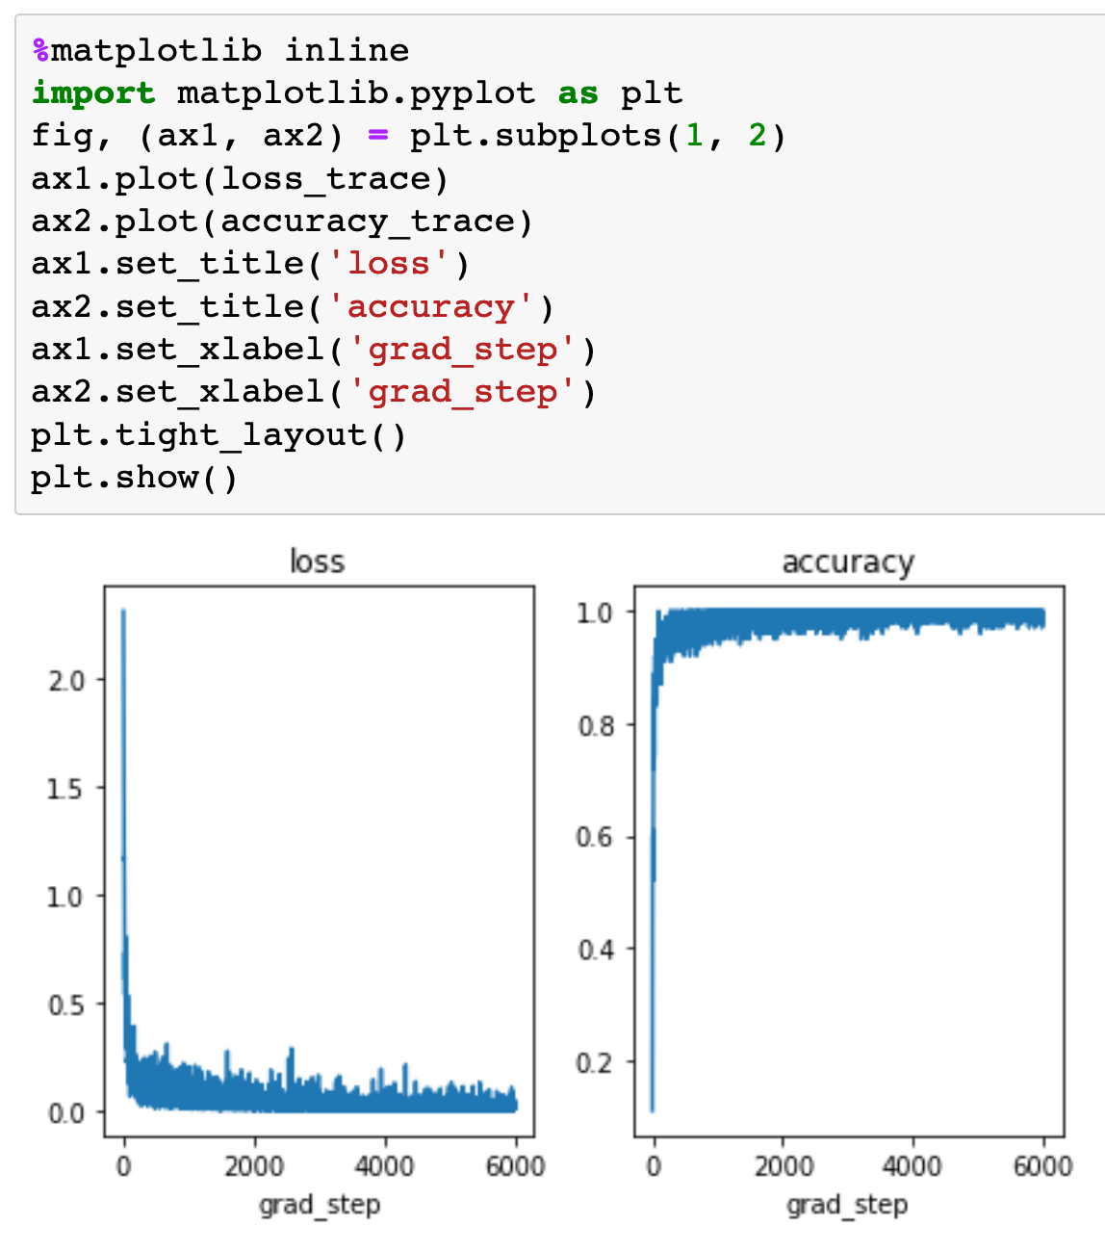

Slide 23
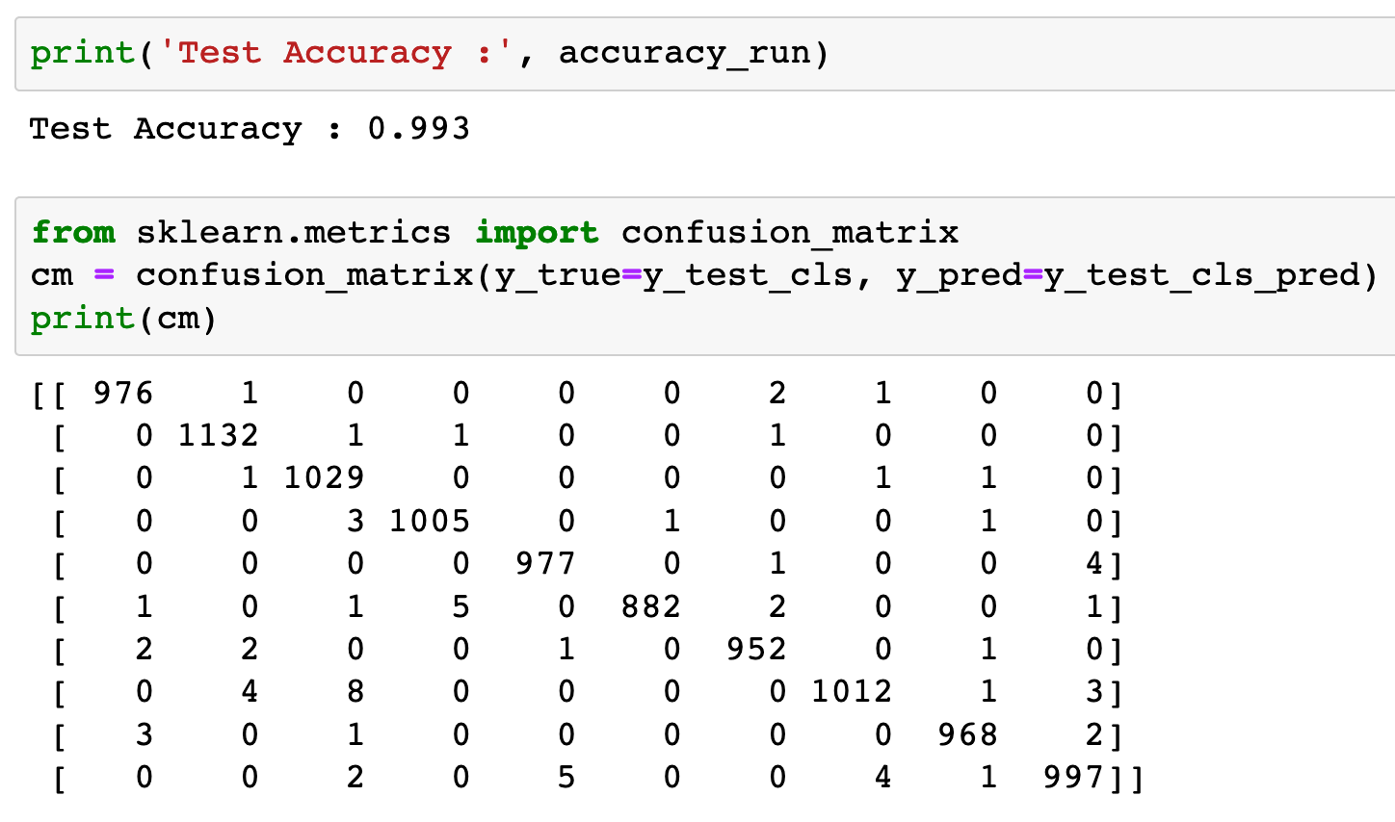

Slide 24
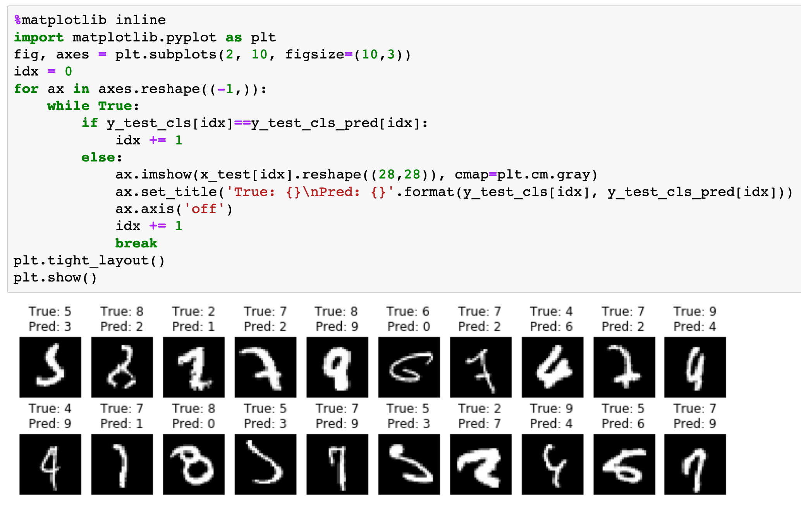

Slide 25
Source Code

Slide 26
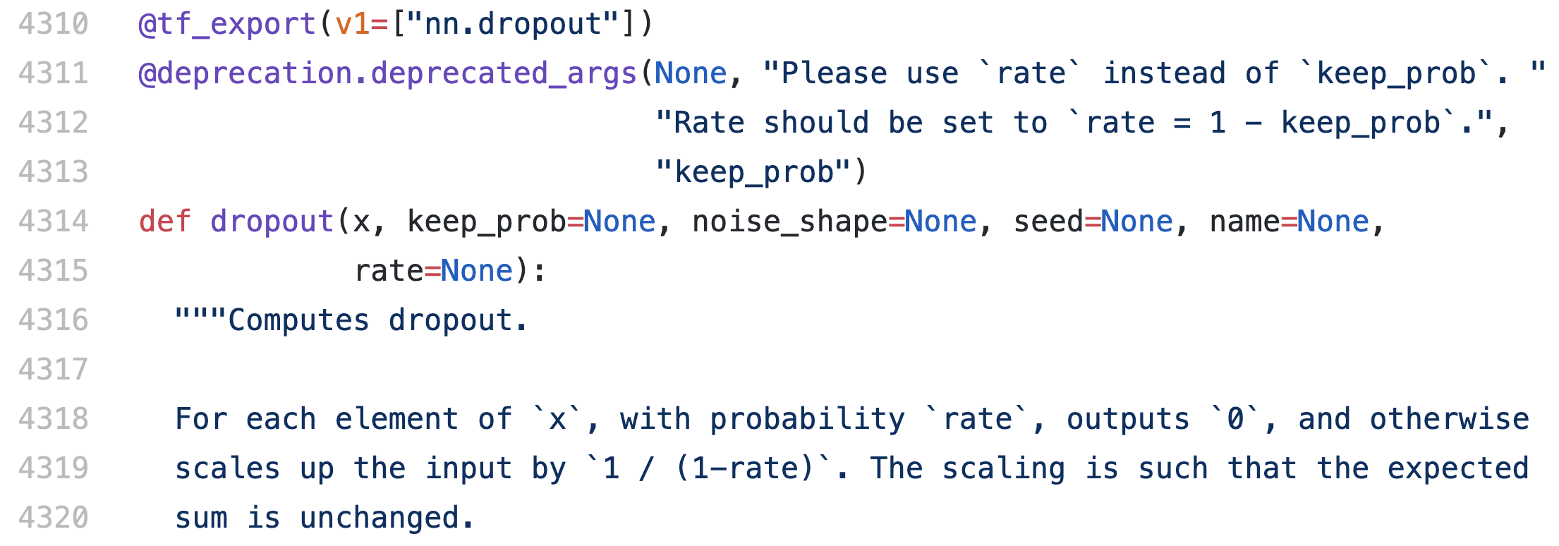
Source Code

Slide 27
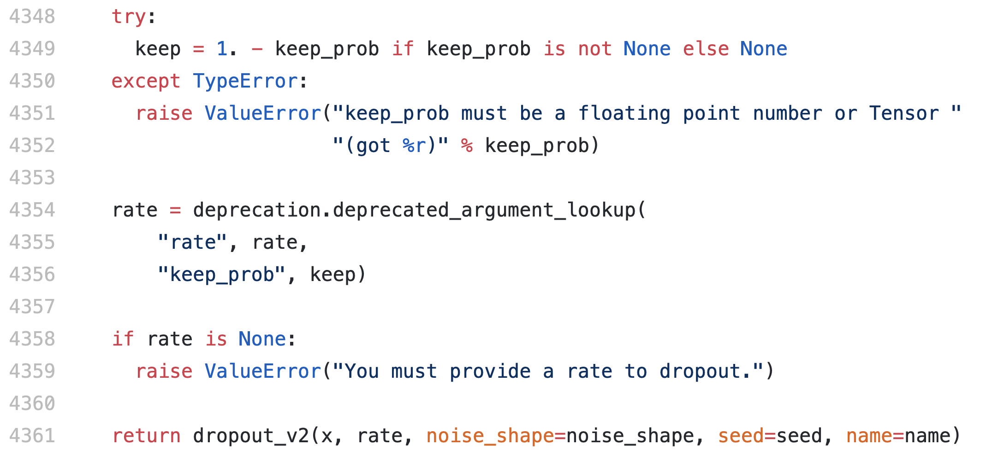

Slide 28
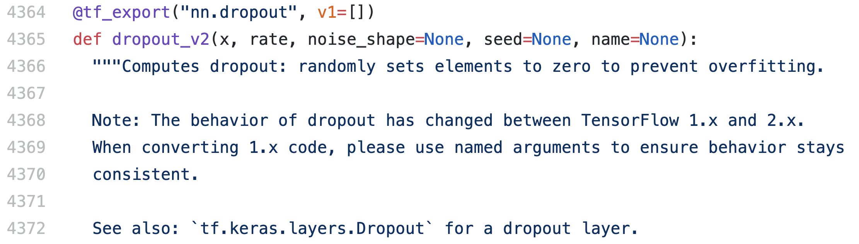

Slide 29
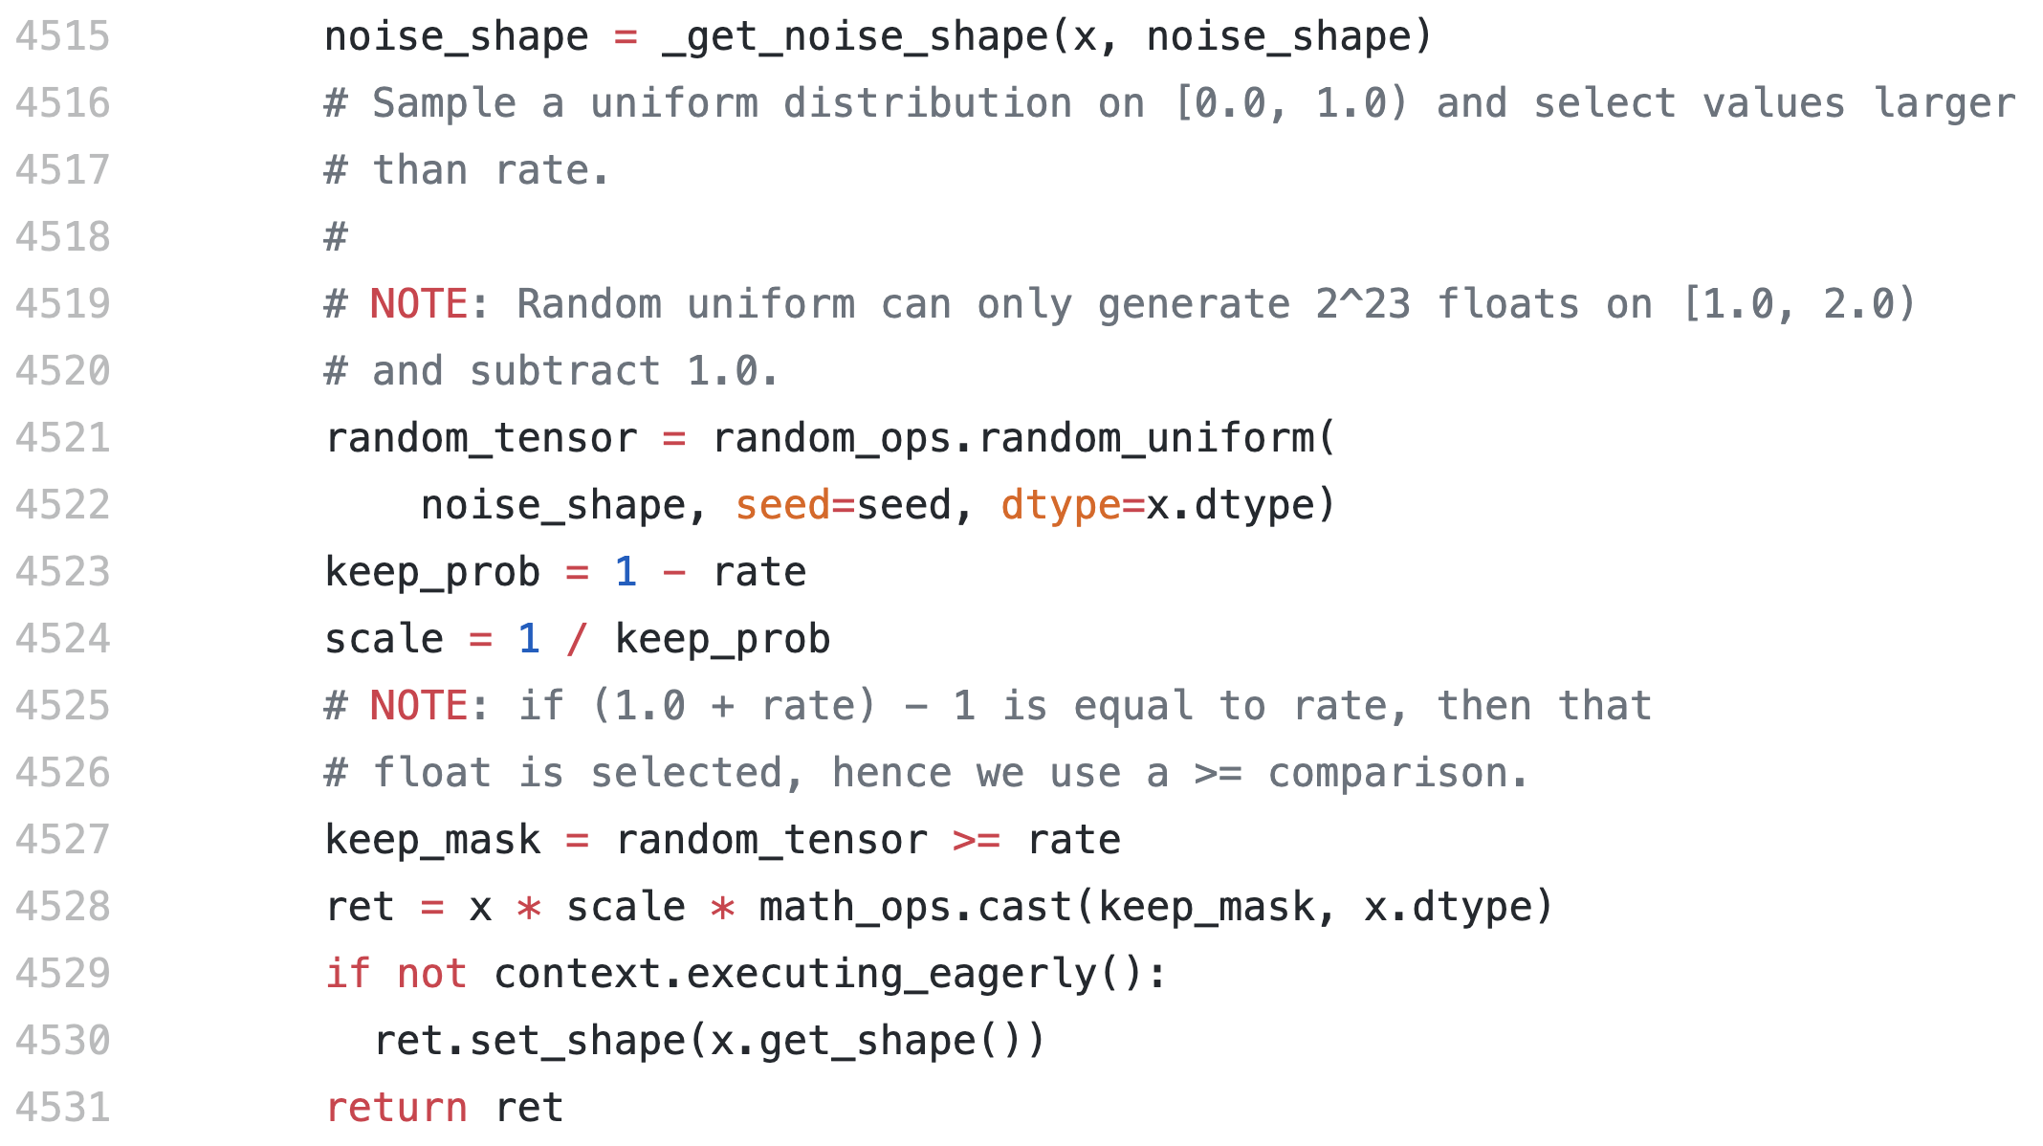

Slide 30
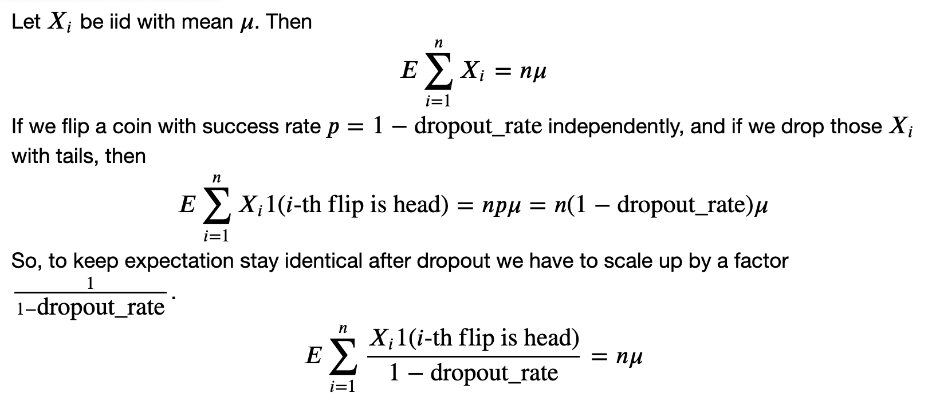

Slide 31
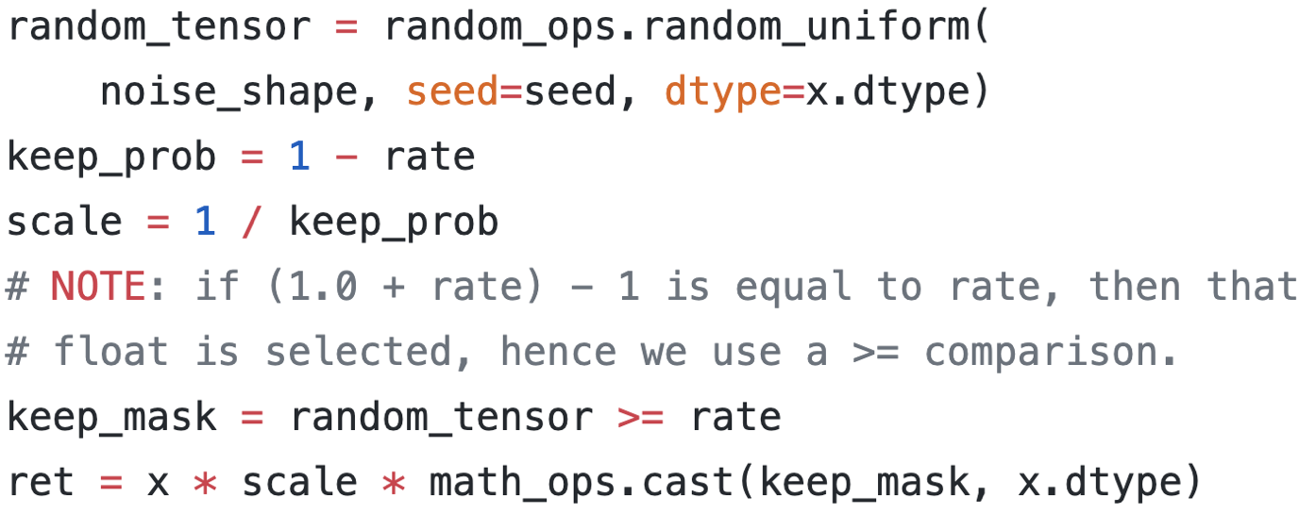
Train Period

Slide 32
Test Period

Slide 33
Now
Let’s Play with Code

